Slide 2
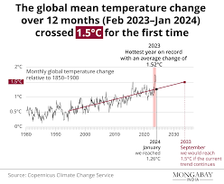

Slide 3
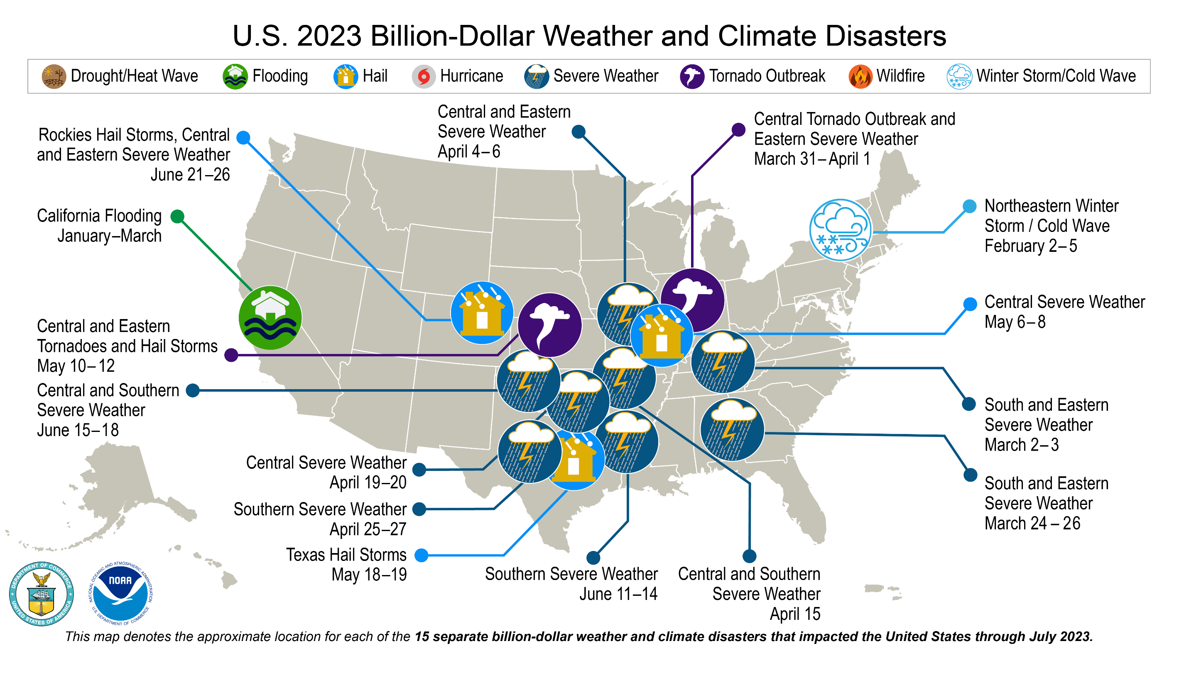

Slide 4
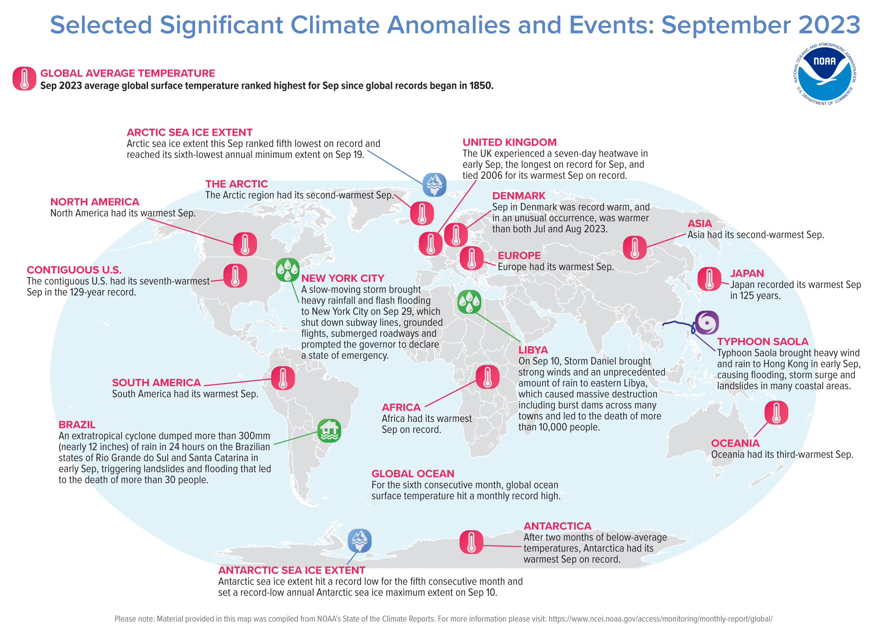

Slide 5
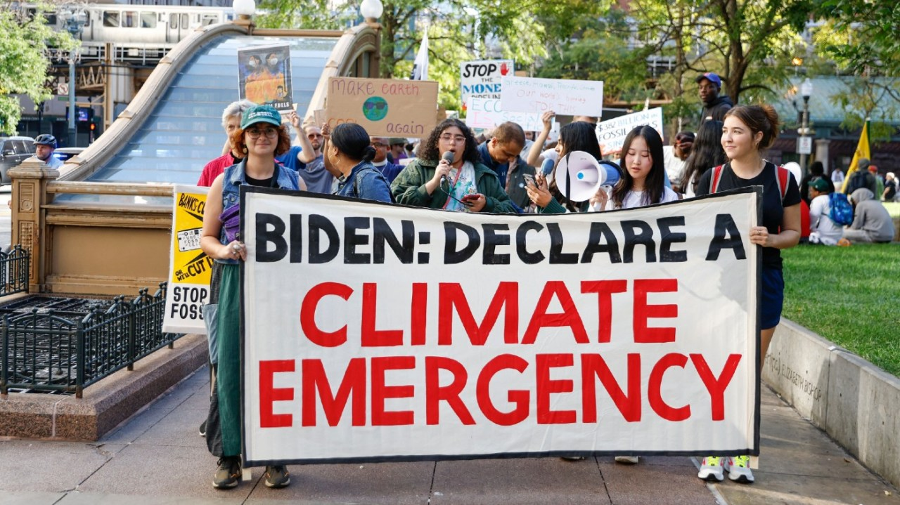

Slide 6
Call President Biden :202-456-1111 (On Tuesday April 11 between 11 AM to 3 PM ET); email comments@whitehouse.gov; or via internet https://www.whitehouse.gov/contact/
Message: We need bold action now on climate change. We need the President to declare a climate emergency and take executive action as outlined in climatepresident.org. Enact the Green Party’s original ecosocialist Green New Deal with an immediate halt to new fossil fuels: a rapid ten-year transition to real zero emissions and 100% clean renewable energy; and a comprehensive Economic Bill of Rights. Funds need to be targeted for a Just Transition and environmental justice.

Slide 11
Our Demands
Declare a Climate Emergency to rapidly advance just, renewable energy
Ban Federal Fossil Fuel Leasing, to end onshore and offshore drilling
Stop the Federal Approval of All New Fossil Fuel Projects and Exports

Slide 12
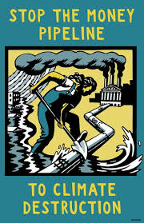
SEND WALL STREET A MESSAGE: FUND CLEAN ENERGY, NOT FOSSIL FUELS
Since the Paris Agreement was adopted, Wall Street banks have provided $1.4 trillion to the fossil fuel industry. Big asset managers are the world’s largest investors in coal, oil, and gas. Insurance companies provide insurance for new fossil fuel projects without which they could not be built.
https://stopthemoneypipeline.com/

Slide 13
Oppose False Climate Solutions

Slide 14
Eight out of 10 people support cutting plastic production ahead of the fourth Intergovernmental Negotiating Committee (INC4) meeting for a Global Plastics Treaty to be held in Ottawa, Canada on April 23 BeyondPlastics.org

