Slide 1
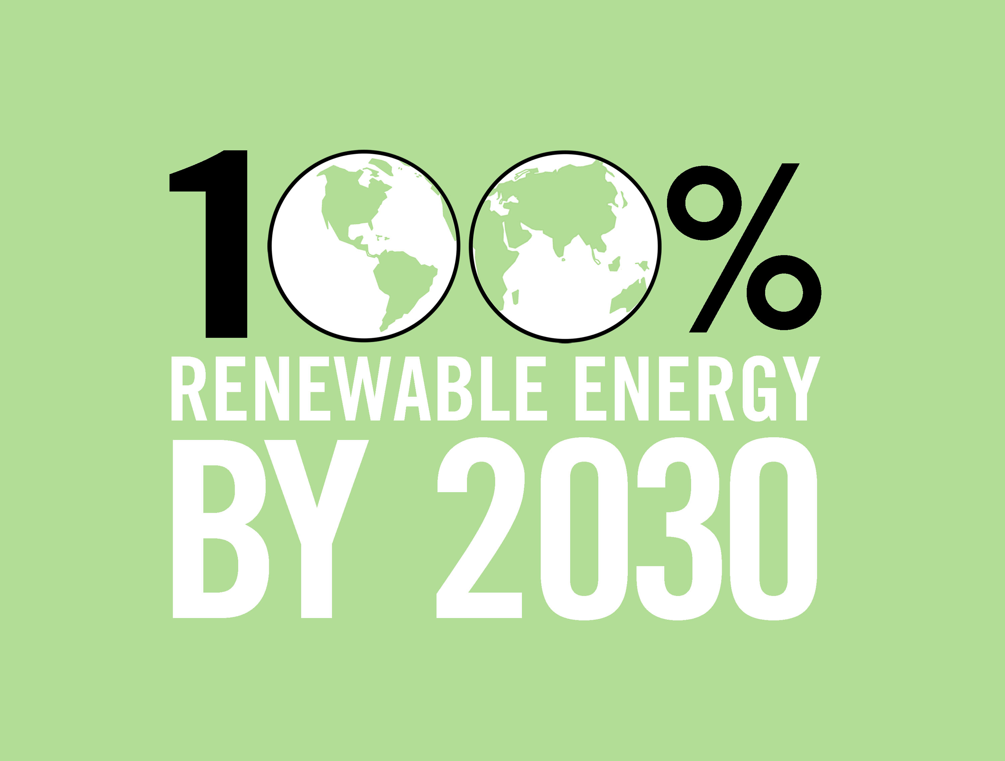
Green Education and Legal Fund www.gelfny.org

Slide 2
Many of these slides prepared by
The Solutions Project thesolutionsproject.org/
Physcians, Scientists and Engineers for Healthy Energy
Dr. Tony Anthony Ingraffea, Cornell
Trade Unions for Energy Democracy Sean Sweeney

Slide 3
What’s the Problem? Why Act Quickly?
Air pollution from fossil and biofuels causes 2.5 - 4 million premature deaths worldwide annually. An estimated 3,100 in NYS.
Climate change is real, and effects are becoming more evident. We have 15 years to take effective action. Increased temperatures must be kept below 1.5 degrees C to avoid catastrophic change.
Arctic sea ice may disappear in 10-30 years. Permafrost is melting.
Increasing fossil energy use increases pollution, warming, and energy prices.
Higher fossil energy prices lead to economic, social, political instability. Wars for food and water. Already 400,000 annual deaths from climate change.

Slide 4
There is an Energy Emergency
The Three RISINGS => Climate & Environmental Crises
Fossil fuel demand
Greenhouse gas emissions
Harmful pollution
Fossil fuel corporations’ power grows
Attacks on workers and unions have intensified
More energy ≠ More access
Notes:
There is an energy emergency and it will intensify and worsen without serious intervention.
The emergency consists of four main parts – the 3 risings – rising fossil fuel demand, rising GHG emissions, and rising pollution.
I’ll spend most of my time speaking to these three risings but the energy emergency consists of 3 other components:
Fossil fuel corporations are growing more and more powerful, making it harder to democratically control the energy system and realize an energy system that is equitable, sustainable, low-carbon and strengthens workers’ rights and unions.
#3, attacks on workers and unions have intensified, both within the energy sector and outside of it as fossil fuel companies flex their muscles to shift the entire political landscape.
#4, more energy coming into the global energy system has not met more people have access to electricity. Energy poverty is negatively impacting the health and quality of life for billions of people around the planet.

Slide 5
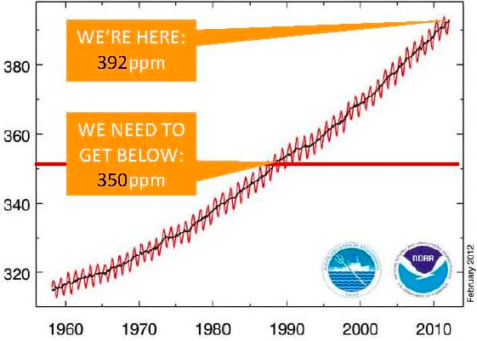
Political Target = Keep warming below 2°C What we really need = 1.5°C Now=400 PPM CO₂ Target=350PPM CO₂ C
Notes:
The current political consensus, as captured in the UN climate negotiations process, is that average global warming needs to stay below 2 degrees to avoid the worst impacts of climate change.
However, the scientific consensus is that the global average temperature cannot increase more than 1.5 degrees and the concentration of CO2 in the atmosphere needs to get down below 350 PPM, or we may hit irreversible climate tipping points.
The concentration of CO2 in the atmosphere currently is 392PPM, so we need to significantly reduce CO2 emissions to reach the 350 target.
As you can see from this picture, an international grassroots movement has emerged to demand countries commit to the 350PPM target.

Slide 6
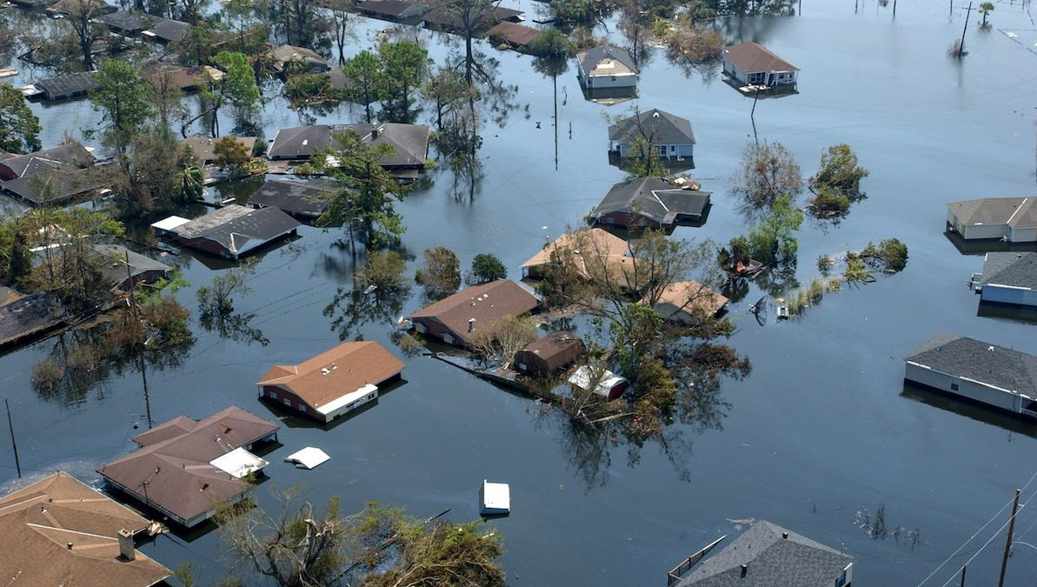
GLOBAL CLIMATE DISRUPTION IS ALREADY HERE
We have warmed only +.85C so far.
This kills 400,000 people every year.
Pentagon: Climate change "poses immediate risks to U.S. national security.”
Approaching irreversible climatic tipping points.
Notes:
Refer back to the Syria example

Slide 7
Impact of 0.8°C Warming is Far Worse Than Scientists Expected
Notes:
Human induced CO2 emissions have already raised the average global temperature by 0.8 degrees celsius.
The impact of this amount of warming has been far worse than scientists expected, reinforcing that we need to take immediate action to dramatically reduce emissions.
One-third of the Arctic’s summer sea ice is gone.
Climate change has caused 90% of mountain glaciers to visibly retreat, and under a business-as-usual scenario, they could be completely gone by 2100.
The deflation and retreat of glaciers will lead to more and more floods and water scarcity, as it has already done in parts of the world like Bolivia and Peru.
Ocean’s are 30% more acidic, as they try to absorb carbon, and this is threatening to collapse marine ecosystems.
In order to stay within a tolerable climate range, 40% of wild plants and animals have relocated Other have no place to go.
Extreme weather events, like flooding, droughts, fires, tsunamis, are now a daily occurrence around the globe.
And it’s the working class, people of color, women, immigrants and others marginalized by the current political-economic system that are disproportionately impacted by climate change.

Slide 8
Fossil Fuel Corporations’ Extreme Energy Agenda – Far Riskier for Workers, Communities & Environment
Tar Sands Oil
Shale gas “fracking”
Mountaintop removal and surface coal mining
Deep sea / Artic oil drilling
Notes:
Not only are fossil fuel corporations investing billions in fossil fuel expansion, they are pursuing an “extreme energy” agenda.
Higher costs of energy, greater profits, new technologies and diminishing sources of easy to reach fossil fuels, has led fossil fuel corporations to pursue energy extraction processes that are far riskier for the workers doing the work, the communities that live nearby and for the environment.
This agenda includes getting tar sands oil, hydraullic fracturing, or fracking, for shale gas, mountaintop removal and surface coal mining and deep sea and Artic oil drilling.

Slide 9
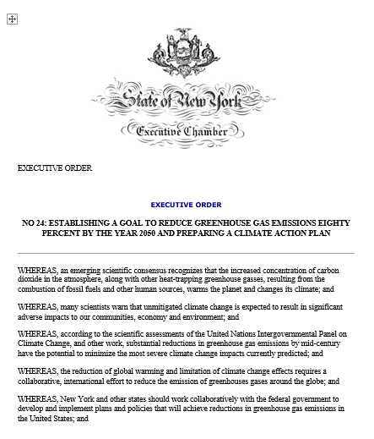
Executive Order #24
by Gov. Paterson (2009)
to address the critical issue of climate change
Climate Action Council
Charged with preparing a Climate Action Plan
(draft report by Nov 2010 and final report by May 2011)
“It shall be a goal of the State of New York to reduce current greenhouse gas emissions from all sources within the State eighty percent (80%) below levels emitted in the year nineteen hundred ninety (1990) by the year two-thousand fifty (2050).”

Slide 10
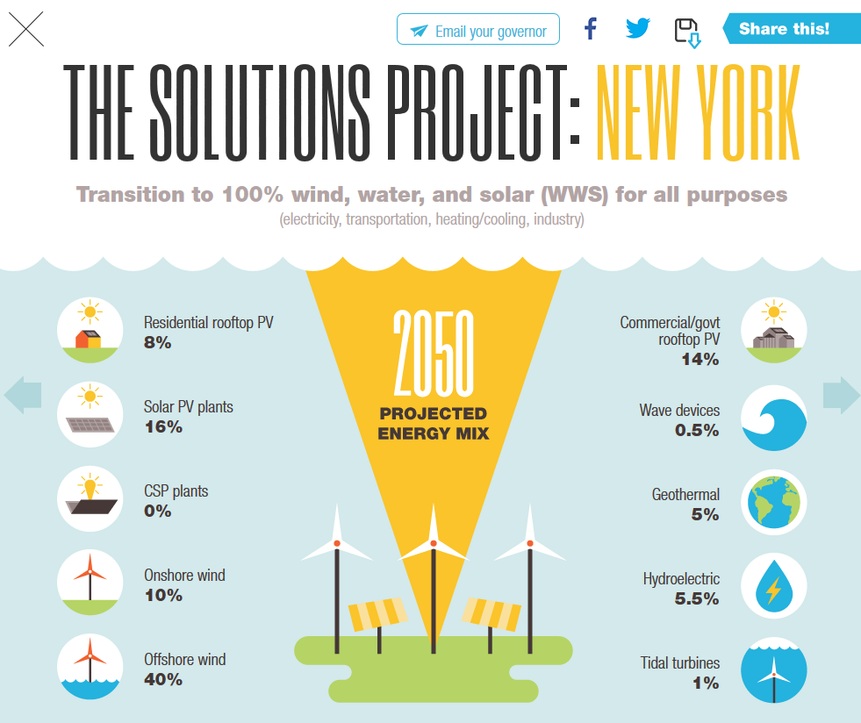

Slide 11
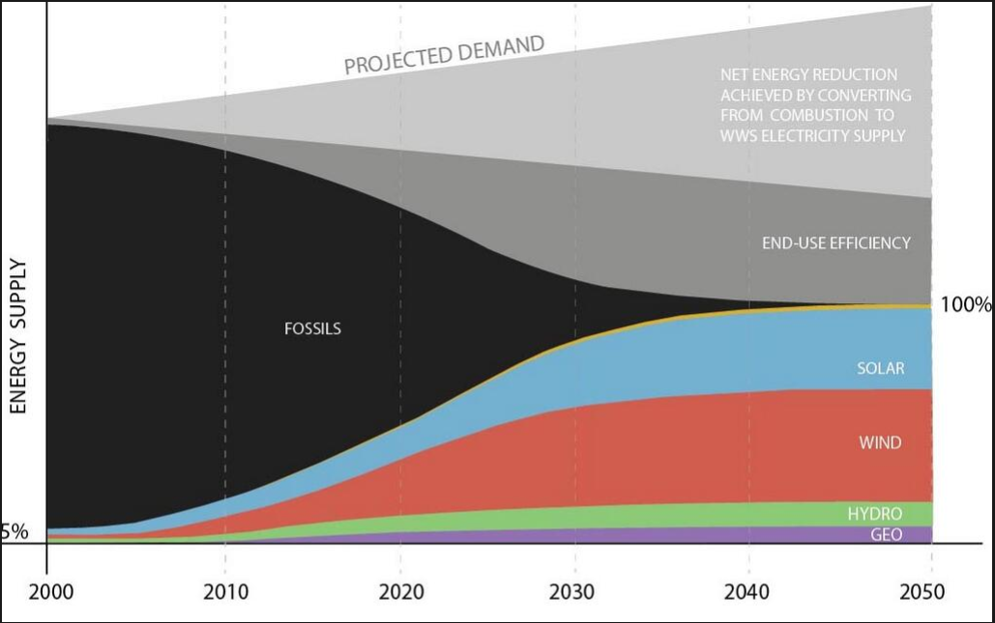
Solutions Project Plan for NYS
Jacobson et al., Energy Policy, Feb. 2013

Slide 12
Solutions Project Convert NYS’s All-Purpose
Energy Infrastructure to One Derived Entirely from
Wind, Water, and Sunlight
NYS’s all-purpose end-use power would be provided by:
Energy Technology | % of 2050 energy demand met by plant/device | Additional capacity needed (MW) | Number of new plants or devices needed
Onshore wind | 10.0 | 18,391 | 3,678
Offshore wind | 40.0 | 58,924 | 11,784
Wave device | 0.5 | 1,405 | 1,872
Geothermal plant | 5.0 | 3,467 | 34
Hydroelectric plant | 5.5 | 915 | 1
Tidal turbine | 1.0 | 2,544 | 2,544
Res. roof PV system | 8.0 | 41,910 | 8,382,042
Com/gov roof PV system | 14.0 | 69,291 | 692,906
Solar PV plant | 16.0 | 57,521 | 1,150
Jacobson et al., Energy Policy, 2013

Slide 13
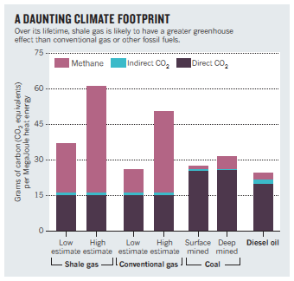
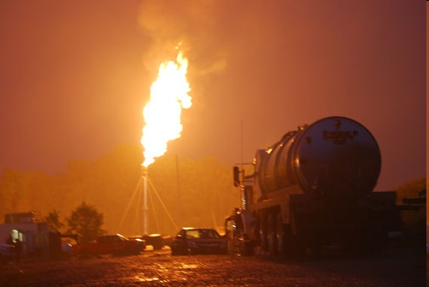
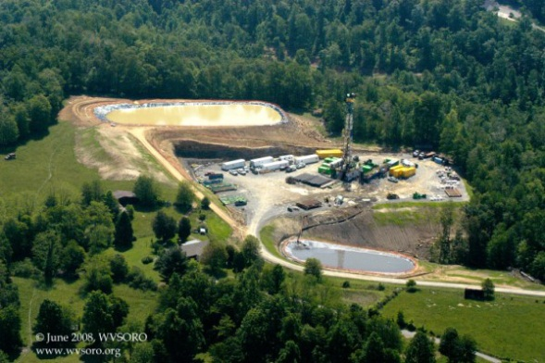
Very Strong “No” to Natural Gas
Disastrous for global warming, because of
methane emissions
50-70 times more CO₂ and air pollution per kWh
than wind
High-volume hydraulic fracturing requires large
quantities of water, and has high levels of water
and air pollution
For shale gas, clustered, multi-well pads
with long laterals with very high spatial
intensity and heavy industrial footprint

Slide 14
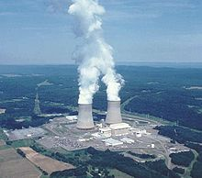
Why Not Nuclear Power?
9 to 25 times more pollution per KWh than
for wind, from mining, refining, and
construction
Risk of meltdown (1.5% of all nuclear
reactors to date have melted down)
High risk of nuclear weapons proliferation
Unresolved high-level nuclear waste
disposal issues. Expensive to build.
Construction time too long: too late in the
fight against climate change

Slide 15
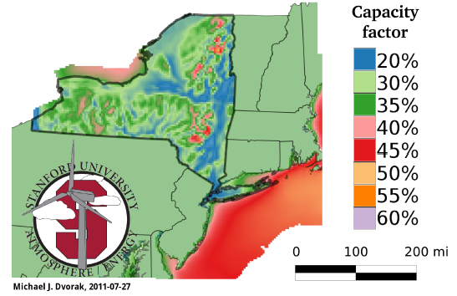
MYTH: It Is Not Windy Enough in NYS
to Make Wind Energy Practical
Wind Capacity Factors at 90-m Hub Height in NYS. Capacity factors of 30% or higher are the most cost-effective for wind energy development.
Jacobson et al., Energy Policy, 2013

Slide 16
NYS: 4-4.5 kWh/m²/day)
MYTH: It Is Not Sunny Enough in NYS
to Make Solar Energy Practical

Slide 17
Conversion to Renewable Energy will Create Jobs in New York State
Average number of jobs in the US per million dollars spent on energy production:
3.7 for fossil fuels
9.5 for wind
9.7 for solar
Info.ussolarinstitute.com
Source: “The Economic Benefits of Investing in Clean Energy”,
U. Mass, Dept. of Economics & Policy Research Institute, June 2009.

Slide 18
Estimated Job Creation in New York State with SOLUTIONS PLAN
Energy Technology | Construction Jobs | Operations Jobs
Onshore wind | 1,832 | 2,745
Offshore wind | 10,148 | 37,128
Wave device | 474 | 3,325
Geothermal plant | 1,214 | 411
Hydroelectric plant | 275 | 275
Tidal turbine | 752 | 5,770
Res. roof PV system | 62,514 | 19,206
Com/gov roof PV system | 110,213 | 22,259
Solar PV plant | 51,510 | 16,808
TOTALS | 238,931 | 107,926

Slide 19
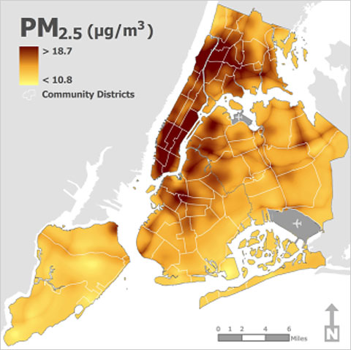
Fossil-fuel air pollution causes 4,000 deaths per year in New York State. Deaths and other health costs = $33 billion per year in New York State.
Aerosol particle pollution in NYC during winter 2009 (values above 7 ug/m³ increase mortality the most)
http://graphics8.nytimes.com/images/2009/12/15/nyregion/air-480.jpg

Slide 20
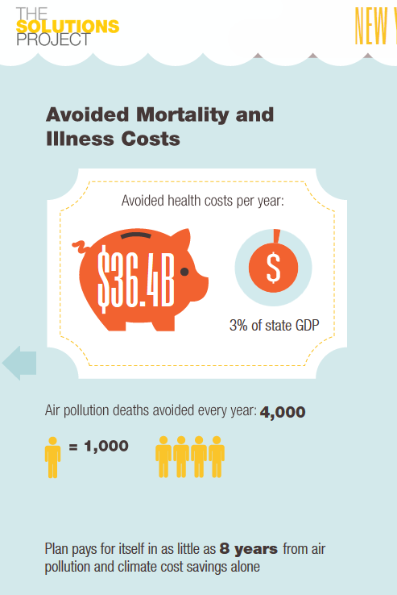
And…
NYS’s own emission
decreases would reduce
2050 U.S. climate costs
by $3.2 billion/yr.

Slide 21
Estimated Cost of Renewable Energy Sources in New York State
Energy Technology | Cost (billion)
Onshore wind | $ 25.7
Offshore wind | $ 176.7
Wave device | $ 4.2
Geothermal plant | $ 5.9
Hydroelectric plant | $ 1.8
Tidal turbine | $ 7.6
Res. roof PV system | $ 73.3
Com/gov roof PV system | $ 103.9
Solar PV plant | $ 86.2
TOTAL | $ 485.6
Compared to what?
50,000 shale gas wells, alone, will cost $250B

Slide 22
Costs of Energy, Including Transmission (¢/kWh)
Delucchi & Jacobson (2010)
Energy Technology 2005-2010 2020-2030
Wind onshore 4-7 ≤4
Wind offshore 10-17 8-13
Wave >>11 4-11
Geothermal 4-7 4-7
Hydroelectric 4 4
Solar PV 9-13 5-7
Tidal >>11 5-7
Conventional (+Externalities) 7 (+5)=12 8-9 (+5.5) =13.5-14.5

Slide 23
Our Plan Stabilizes and Reduces Energy Costs Compared to Fossil Fuels

Slide 24
Matching power generation to demand:
Interconnect wind turbines over a large enough area to even out system-wide power generation
Use hydro-power and stored solar power to help balance demand
Oversize generation capacity, and produce hydrogen with excess (for feeding back into the grid through fuel cells, and for industrial process heat energy)
Use demand-response management to shift demand to match power generation
Store energy through pumped hydroelectric, compressed air, flywheels, and batteries (particularly in electric vehicles)
Store heat energy seasonally through geothermal ground exchange.

Slide 25
The Plan: Summary
Electrify transportation and commercial and domestic heating – greater efficiencies lower total energy consumption (37%).
Choose most environmentally benign generation technologies (50% wind, 36% photovoltaic, and 14% geothermal, hydro, tidal, and waves).
Rely on technologies that are commercially available today.
Use a variety of energy storage techniques, and approaches for balancing demand to production.
Use hydrogen (generated from excess electricity production) for industrial process energy and as a transportation fuel for airplanes, long-distance trucks, and ships.

Slide 26
Plan: Summary
Is cost effective ($486 billion price tag is paid off entirely in health-cost and climate-cost savings of $36 billion per year over 14 years)
Creates large number of net new jobs in New York.
Stabilizes energy prices, and greatly improves energy security; reduces energy prices on the time scale of 10 or more years into the future. Nobody owns the sun/wind/water.
Hugely decreases air pollution and greenhouse gas emissions from New York.

