Slide 1
Environmental Advocacy + Carbon Tax
Sara Hsu

Slide 2
Environmental Advocacy
Necessary for many reasons, most prominently because of climate change. Climate change has become a pressing problem.
Pope Francis called for action on climate change, stating that it “no longer be left to a future generation".
President Obama said, “we can choose to believe that Superstorm Sandy, and the most severe drought in decades, and the worst wildfires some states have ever seen were all just a freak coincidence, or we can choose to believe in the overwhelming judgment of science—and act before it’s too late.”

Slide 3
Climate Change is Happening
Scientific evidence for warming of the climate system is unequivocal. - Intergovernmental Panel on Climate Change
Sea level rise: Global sea level rose about 17 centimeters (6.7 inches) in the last century. The rate in the last decade, however, is nearly double that of the last century.
Global temperature rise: All three major global surface temperature reconstructions show that Earth has warmed since 1880.⁵ Most of this warming has occurred since the 1970s, with the 20 warmest years having occurred since 1981 and with all 10 of the warmest years occurring in the past 12 years.⁶ Even though the 2000s witnessed a solar output decline resulting in an unusually deep solar minimum in 2007-2009, surface temperatures continue to increase.

Slide 4
Warming oceans: The oceans have absorbed much of this increased heat, with the top 700 meters (about 2,300 feet) of ocean showing warming of 0.302 degrees Fahrenheit since 1969.
Retreating Glaciers: Glaciers are retreating almost everywhere around the world — including in the Alps, Himalayas, Andes, Rockies, Alaska and Africa.
Extreme events: The number of record high temperature events in the United States has been increasing, while the number of record low temperature events has been decreasing, since 1950. The U.S. has also witnessed increasing numbers of intense rainfall.
-NASA

Slide 5
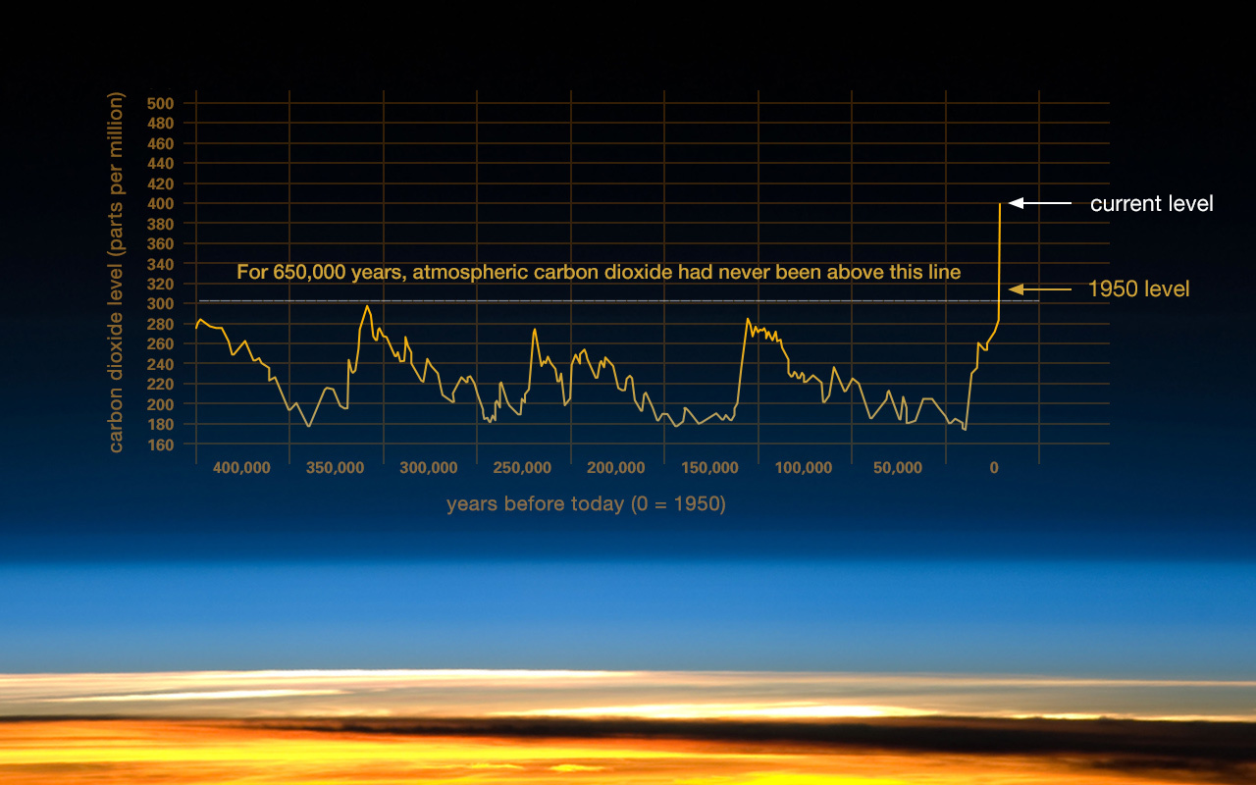

Slide 6
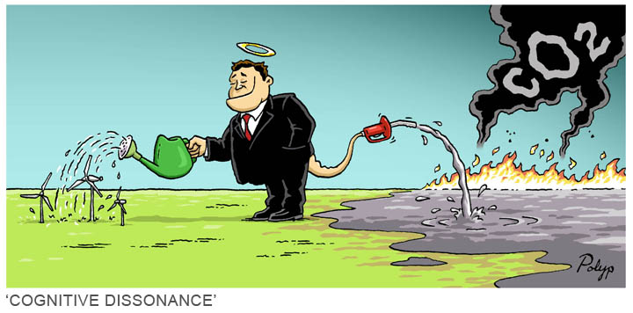

Slide 7
Many Policy Solutions to Climate Change
Centers on energy policy:
Fuel economy and energy efficiency standards
Renewable energy development
Adaptation measures such as expansion of infrastructure, changing zoning regulations
Carbon cap and trade systems and carbon taxes

Slide 8
Advocacy Pathway
From information to modelling
From modelling to reporting and publicizing
Identifying appropriate legislators
Lobbying and meeting
Drafting legislation
Getting the bill introduced
Gathering support for the bill
Lobbying and meeting
Getting the bill through

Slide 9
Purpose of a Carbon Tax
A carbon tax places a tax on fossil fuels produced or distributed in the area, based on how many metric tons of carbon are emitted into the atmosphere, and repays the tax to the consumer or producer through tax refunds or uses revenues for other purposes.
The purpose of the policy is to send a price signal to consumers and producers that includes the cost of pollution, thereby changing consumer and producer behavior via economic incentives.

Slide 10
NYS Carbon Tax a Class Effort
This workshop and the carbon tax effort in general grew out of an Economics class project at this university.
We began to look at climate change solutions and, as a class, and realized that a carbon tax was among the most feasible solutions across the globe.
Takeaway is that students and young people in general care about climate change and need a clear outlet through which to express their concerns.

Slide 11
NYS Economists Support a Carbon Tax
Mark Gertler, NYU
Thomas Sargent, NYU
Michael Grossman, CUNY
Raquel Fernandez, NYU (at a lower level)
Graciela Chichilnisky, Columbia University
Laura Veldkamp, NYU
Sean MacDonald, CUNY
Robert Frank, Cornell University (at a high level)
Marco Battaglini, Cornell University
Kaushik Basu, Cornell University
Ben Ho, Vassar College (at a lower level)
Mona Ali, SUNY New Paltz
Gary Fields, Cornell University
Willi Semmler, New School
Gerald Marschke, SUNY Albany
Duncan Foley, New School
Simin Mozayeni, SUNY New Paltz
Sara Hsu, SUNY New Paltz

Slide 12
Governor David Paterson’s Pledge
New York State Executive Order Number 24, laid out by New York Governor David Paterson in 2009, sets forth the goal to reduce greenhouse gas emissions in the state by 80% of 1990 levels by the year 2050--about 40 million metric tons. CO₂ levels reached 187.57 million metric tons in 2010.
New York State will in fact not reach a level of CO₂ emissions 80% below 1990 levels by 2050 if the state does not continue to take serious action.

Slide 13
Proposed Carbon Tax
A carbon tax imposed on crude oil and gasoline in New York State, at a rate equivalent to $180 per metric ton of carbon dioxide emitted, would generate revenue while addressing climate change.
The tax currently proposed would start at $35, increasing $15 each year until reaching $180. 60% of revenues would be returned to low and moderate income households, while 40% would go to climate change adaptation, mass transit, and transition to renewable energy.

Slide 14
Impact of a Carbon Tax
The carbon tax would dramatically reduce CO2 emissions, cutting them by over half.
Carbon tax revenues would amount to over $14 billion. This would leave $5.6 billion to programs such as mass transit, climate change adaptation, and transition to renewable energy.
$8.4 billion would be returned to the lowest income groups to shield them from the burden of the tax.
Returning funds to the poor will shift their spending toward consumption of other goods and services. This in itself is job-creating.

Slide 15
New York is Transforming Energy
New York State is already attempting to transform its energy sector by focusing on the following goals as part of its New York State Energy Plan for 2014: increasing energy affordability, enhancing private sector energy financing, strengthening the power grid, increasing customer control over energy use, and meeting energy innovation with market.
The CO₂ Tax policy on fossil fuels will help to further shift the energy landscape.

Slide 16
Costs of Climate Change are High
One can contrast the impact of a carbon tax on the economic impact of Hurricane Sandy alone. While a carbon tax is predicted to generate revenue, switching spending from capital-intensive fossil fuel industries to labor-intensive consumer industries, failing to implement economic policies to reduce the impact of climate change will have serious economic consequences.
During Hurricane Sandy, the New York City metro area lost 32,000 jobs in the immediate aftermath of the storm, particularly in the utilities, chemicals, food, transportation equipment and computers and electronic products sectors

Slide 17
Aim of the Workshop
The aim of this workshop is to discuss how one can advocate for environmental causes in general, what past experiences have been like, and how the carbon tax specifically has been proposed and enacted.
We welcome: Mark Dunlea, President of the Green Education and Legal Fund; Steve Breyman, Associate Professor of Peace, Environmental and Media Studies at Rensselaer Polytechnic Institute; Jannette Barth, President of J.M. Barth & Associates Inc.; and Charles Komanoff is Director of the Carbon Tax Center.
The morning will consist of lectures from experienced NYS environmental advocates on advocacy and the carbon tax, while the afternoon is reserved for discussion about the NYS carbon tax.
Lunch will be served from 12-1; we can also take a working lunch if so chosen to get a jump start on the afternoon session, and can end earlier than 4 pm if desired (perhaps 3 pm).

